Slide 1
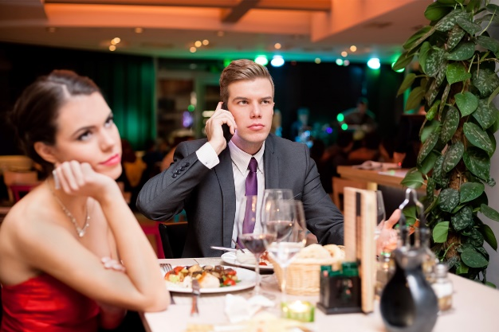
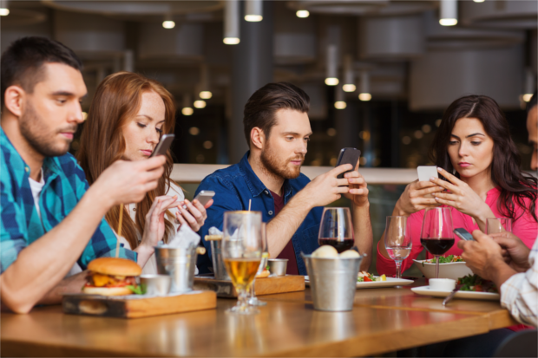
I-Gen
We learn to rely on our friends
But you can’t really count on your friends
Trending
Generations are rippling up
What do you want?
Parenting
Technology
Impatience
Environment
How do you form deep meaningful relationships?
Create a word bank for discussion
What things really really matter to you
Lower self esteem than previous generations
Diversity (I-Gen)
What is real joy for you
Catchup - older generations are starting to look like younger generations
Generations are clues on how you – lead, learn, train, sell,
What is your corporate environment like –
Balance
Working hard
Numbers v ling term life
confidence
We now need the approval of our peers
I’m not making an impact
If you don’t have the phone – you remove the temptation
Generations are predicated by behaviours
Christopher Bauman – www.chrisbauman.com.au

Slide 2
1. Work life balance? ____________________________________________________________________________________________?
Advanced Question Words
2. Characteristics of your generation ___________________________________________________________________________________________ ?
Pragmatic
stereotype
momentum
3. Managing the multi-generational workplace ___________________________________________________________________________________________ ?
Characteristics
Millennials
4 What events have changed the thinking of your generation? ___________________________________________________________________________________________ ?
We put filters on things
I Gen
No age restrictions on Social media?
5. I-Gen doesn’t see diversity until it is absent…..(diversity is what is normal to you) ___________________________________________________________________________________________ ?
Different trajectories
Generational strengths
6. I-Gen will have no context for going to the grocery store ___________________________________________________________________________________________ ?
Problem solving
hardwired
7. To feel entitled ___________________________________________________________________________________________ ?
Stress
8. An entire generation going through high stress and then getting access to dopamine from social media ____________________________________________________________________________________________ ?
Arduous and long
Dealt a bad hand
Every generation brings something that is important and necessary.
Christopher Bauman – www.chrisbauman.com.au

Slide 3
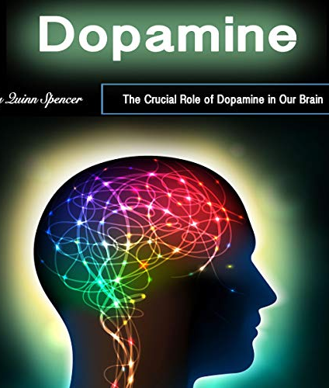
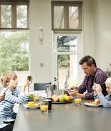
Conversation Class
Value of art
Stress
Curious
Addictive
Turn to social media
Temporary solutions
More FB = Higher depression
Imbalance (what is too much?)
Instant gratification
Social coping mechanisms (dating)
Christopher bAUMAN
A text message feels good?

